Slide 1
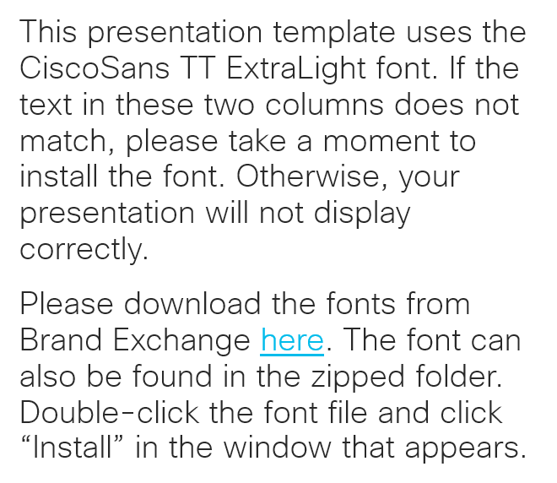
Please read
This presentation template uses the CiscoSans TT ExtraLight font. If the text in these two columns does not match, please take a moment to install the font. Otherwise, your presentation will not display correctly.
Please download the fonts from Brand Exchange here. The font can also be found in the zipped folder. Double-click the font file and click “Install” in the window that appears.

Slide 2
RTC-AMP-ISE Script
Working within confines of our self-inflicted limits
Aaron T Woland, CCIE #20113, Principal Engineer - Advanced Threat Security
Neil Patel, API Guru, Technical Marketing Engineer – Advanced Threat Security
Rev: July 2017

Slide 3
RTC-AMP-ISE Python Scripts
Script to identify computers in AMP that have had certain events fire:
Threat Quarantined
Threat Detected
Move computers w/ those events into new groups in AMP
ATW-Isolated – computers who have had Threat Quarantined events
ATW-Triage – computers who have had Threat Detected events
Assign ANC labels to those endpoints for Rapid Threat Containment
ANC-KickFromNetwork – computers who have had Threat Quarantined events
ANC-Investigate – computers not in first group who have Threat Detected events

Slide 4

ISE
AMP
Linux Server w/ Python
Get event ID’s for Threat Quarantined & Threat Detected
Response w/ Event ID’s
Setup
Get Group GUIDs for the 3 groups we focus on
Response w/ Group GUIDs
Query for Computers in Group w/ TQ Event ID
Threat Quarantined
.json containing computer list
Query for mac_addr’s of each computer
.json containing mac_addr list of all interfaces
Assign mac_addr to ANC-KickFromNetwork
Move computer into ATW-Isolate group
Query for Computers in Group w/ TD Event ID
Threat Detected
.json containing computer list
Query for mac_addr’s of each computer
.json containing mac_addr list of all interfaces
Assign mac_addr to ANC-Investigate
Move computer into ATW-Triage group

Slide 5
Let’s see this script in action

